Slide 1
Check in
Get your things out
Quizizz: 443723
As you wait:
What do the terms duration, capacity and encoding mean?
What is the capacity, duration and encoding for each memory store
Reminders:
Phones away
Bags on floor
Books out
Pens out
Whiteboard
Reminders
Assessment: WEEK 7 - INVESTIGATION

Slide 2
The multi-store model of memory
(Atkinson & Shiffrin, 1968)
Vocabulary
model: a simplified way of explaining or representing a process or concept memory: the internal record of some previous event or experience encoded: converted into a form that can be processed by the brain retrieval: the recovery of information stored in the brain
Concept Development - CFU
T/F:
Sensory memory refers to memory retained for a brief period, usually just more than 5 seconds.
Iconic memory is visual memory.
Echoic memory is sound memory.
Most information held in sensory memory is lost very quickly
Checking for understanding:
Why is retrieval an essential part in the process of memory?

Slide 3
The multi-store model of memory
(Atkinson & Shiffrin, 1968)
Vocabulary
model: a simplified way of explaining or representing a process or concept memory: the internal record of some previous event or experience encoded: converted into a form that can be processed by the brain retrieval: the recovery of information stored in the brain
Concept Development - CFU
Term | Definition
 | The recovery of information stored in the brain
 | A psychological version of the original sound, thought, object or concept
 | Conversion of sensory information into a form that can be processed by the brain
 | Retention of the information via networks of neurons
Checking for understanding:
Why is retrieval an essential part in the process of memory?

Slide 4
The multi-store model of memory
(Atkinson & Shiffrin, 1968)
Vocabulary
model: a simplified way of explaining or representing a process or concept memory: the internal record of some previous event or experience encoded: converted into a form that can be processed by the brain retrieval: the recovery of information stored in the brain
Concept Development - CFU
Term | Definition
 | The recovery of information stored in the brain
 | A psychological version of the original sound, thought, object or concept
 | Conversion of sensory information into a form that can be processed by the brain
 | Retention of the information via networks of neurons
Checking for understanding:
Why is retrieval an essential part in the process of memory?

Slide 5

Learning Intention
By the end of the lesson I will be able to:
Explain the difference between maintenance and elaborative rehearsal
Describe the different types of long-term memory
Success Criteria
Everyone
I will have tried out elaborative and maintenance rehearsal
I will have a diagram showing the different types of long-term memory

Slide 6
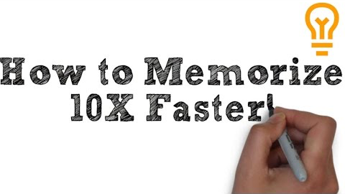
Activate Prior Knowledge
CLASS: WATCH THE MIND, EXPLAINED FROM 2:40 ON NETFLIX, skip to 6.40

Slide 7
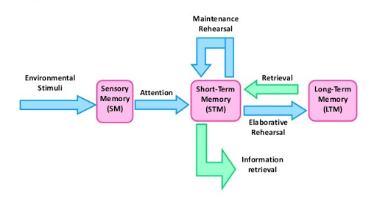
Rehearsal types
Vocabulary
model: a simplified way of explaining or representing a process or concept memory: the internal record of some previous event or experience encoded: converted into a form that can be processed by the brain retrieval: the recovery of information stored in the brain
Maintenance rehearsal | Elaborative rehearsal
Used to keep info in STM | Used to move info to LTM
Shallow processing / surface level processing | Deep processing of info and many retrieval cues made
Repetitive | Links new information to personal experience
Usually acoustic rehearsal | Can be visual, narrative based, mnemonic
Concept Development
Checking for understanding:
When do we use each type of rehearsal Which is better for studying for tests How do you remember information

Slide 8
Elaborative rehearsal
Vocabulary
model: a simplified way of explaining or representing a process or concept memory: the internal record of some previous event or experience encoded: converted into a form that can be processed by the brain retrieval: the recovery of information stored in the brain
Use the link on SEQTA and research the 6 strategies for elaborative rehearsal.
Note down atleast 3
Concept Development
Checking for understanding:
When do we use each type of rehearsal Which is better for studying for tests How do you remember information

Slide 9
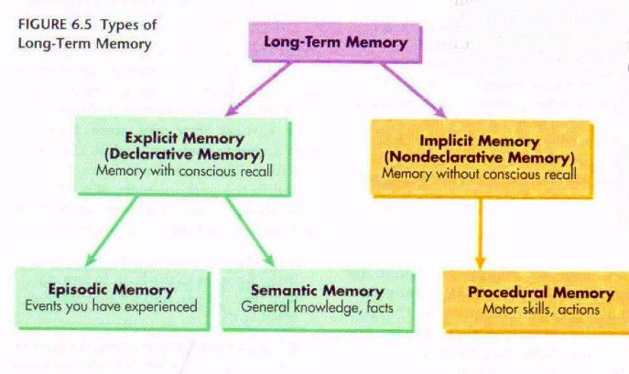
Types of long-term memory

Slide 10
The multi-store model of memory
(Atkinson & Shiffrin, 1968)
Vocabulary
model: a simplified way of explaining or representing a process or concept memory: the internal record of some previous event or experience encoded: converted into a form that can be processed by the brain retrieval: the recovery of information stored in the brain
Long-term memory (n)
In the multi-store model of memory, long-term memory refers to a relatively permanent store of information (from 30s to forever).
Concept Development
Long-term memory
Procedural memory (implicit memory)
Stores the way you do things, the ‘how to’ of memory
E.g. how to ride a bicycle, how to hold a pen, how to swim
The memory of actions and skills that have been learned
It is not a conscious memory process
Mainly refers to the learning of motor skills
Requires little effort to retrieve/retrieval is automatic because the skills are well established and learned
Checking for understanding:
How could we test the proposition that we have greater STM capacity for numbers than for letters. Why do we ‘chunk’ information?

Slide 11
The multi-store model of memory
(Atkinson & Shiffrin, 1968)
Vocabulary
model: a simplified way of explaining or representing a process or concept memory: the internal record of some previous event or experience encoded: converted into a form that can be processed by the brain retrieval: the recovery of information stored in the brain
Long-term memory (n)
In the multi-store model of memory, long-term memory refers to a relatively permanent store of information (from 30s to forever).
Concept Development
Long-term memory
Declarative memory (explicit memory)
The ‘what’ of memory
Requires conscious effort for retrieval
It allows you to ‘declare’ how thing are or what you remember
Episodic: memory for past personal events; an internal representation of your own interpretation of an event; linked to feelings and sensations
Semantic: knowledge of facts and information, based on an understanding and interpretation, often spoken/written material
Checking for understanding:
How is declarative memory different to procedural memory? What is an example of episodic and of semantic memory

Slide 12
Turn and talk to a friend: what do you remember about the types of long-term memory
Concept Development
Task: Draw out the diagram in your notes ensure to define the memory store, explain what type of information it retains and write an example of each type of memory (personal to you).

Slide 13
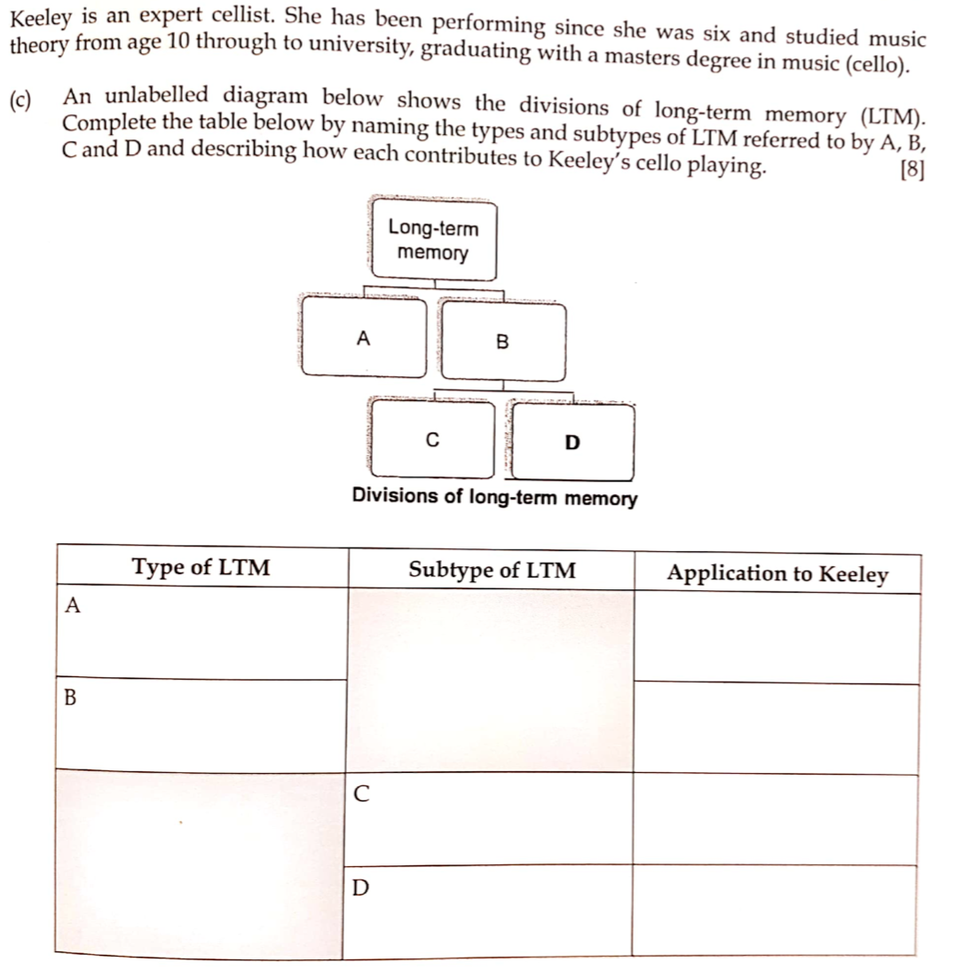
Practice
Check your understanding

Slide 14
Check your understanding
Compare elaborative and maintenance rehearsal
Similarities | Differences
Notes:
Teacher questions:
What are the three divisions of the brain?
What is the oldest part of the brain?

Slide 15
Use elaborative rehearsal for a topic you find hard to remember in biological influences. Choose from:
Neural transmission inside the neuron
Neural transmission between two neurons
Reflex arc
Brain areas for year 12 (PAC, Wernicks, Brocas, PMC, PSC, PVC etc)
Excitatory neurotransmitters and inhibitory neurontransmitters
Check your understanding
Notes:
Teacher questions:
What are the three divisions of the brain?
What is the oldest part of the brain?

Slide 16
Check your understanding
Name 3 elaborative rehearsal techniques?
Notes:
Teacher questions:
What are the three divisions of the brain?
What is the oldest part of the brain?

Slide 17
Check your understanding
Draw out the flow diagram of long-term memory.
Label which ones are consciously recalled and which are unconsciously recalled
Notes:
Teacher questions:
What are the three divisions of the brain?
What is the oldest part of the brain?

Slide 18

Exit Ticket
Ask one, get one

